Slide 1
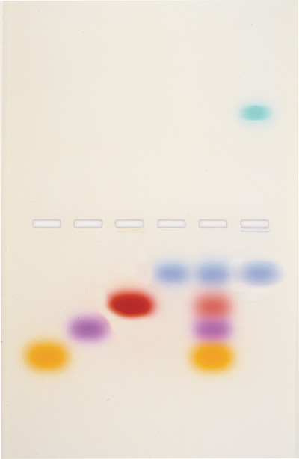
Gel Electrophoresis
Background and instructions

Slide 2
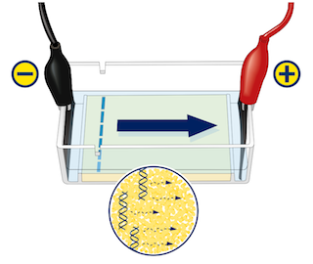
Gel Electrophoresis:
A Separation Process
Gel electrophoresis is a powerful technique used routinely in the areas of human biology, biochemistry, forensics and medicine.
It separates mixtures based on differences in molecular weight (size), structure and charge of the different component molecules.
It is commonly applied to the analysis of DNA and proteins.
Negatively charged
DNA loaded into
the gel at
negative electrode
Molecules migrate to
positive electrode
Notes:
The gel is made from agar which is composed of small pores. The pores allow for the migration of the molecules through the gel.
As the molecules migrate through the pores they experience friction. As a result, smaller molecules experience less friction and migrate faster and further than larger ones which leads to differences in separation.
The electrophoresis we do in schools is a simulation separation technique. It is designed to show students how DNA and protein identification can work. Even though we are using ‘real’ electrophoresis tanks and power packs, we are unable to actually use DNA and proteins as the materials required are either too hazardous or too expensive for school laboratories.
Instead of DNA and proteins we use dyes that behave in a similar way, that is they migrate towards the positive electrode.

Slide 3
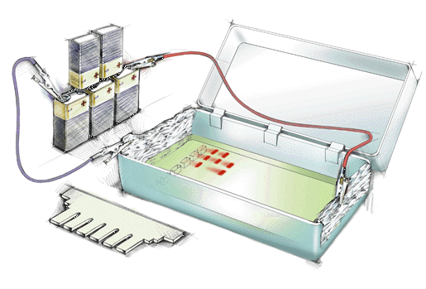
Gel electrophoresis in the school laboratory
Electrophoresis apparatus assembled in the lab
MS 062018
Notes:
Before equipment was available for loan, this was one way to do electrophoresis.
Problems with using this set-up is making up the gear to start with and the cost of batteries. Or, if you use the set-up in STAWA Stage 3: ‘Exploring Human Biological Science’ method on page 68, Activity 10: DNA profiling, the power pack is very slow (being limited to 12V).
A positive was that the gel itself in this type of set-up was quite large so if you were prepared to use a lot of 9V batteries (or time) you could get a good spread of dyes.

Slide 4
Gel electrophoresis loan pool sets
What’s in it?
8 tanks, 8 combs and 8 pairs of leads
4 power packs
8 fixed volume micropipettes
1 variable micropipette
Dyes
Pipetting tips
Eppendorf tubes for dye mixtures
Resources
MS 062018
Notes:
The set contains tanks, power packs, instructions, micropipettes and dyes to safely simulate DNA analysis in secondary school laboratories. This can be used for ATAR Year 12 Biology to complete task 1 in the ‘Heredity’ unit and ATAR Year 12 Human Biology in the ‘Human variation and evolution’ unit. Some schools also use the electrophoresis sets with Integrated science classes and Year 10 genetics.
4 high voltage power packs - 1 between 2 groups of students
8 electrophoresis tanks
8 fixed volume micropipettes. Are $32 each as opposed to the variable volume micropipettes at around $250 each. These are for students to load the dyes, whereas the variable volume micropipette (one in each kit) is for students to have a practice with.
Dyes – we supply similar non-hazardous dyes to those used in ‘Biotech out of the Box’ kits from Murdoch university.
Plus other components in each kit such as spare Eppendorf tubes, tube racks and instructions/resources.

Slide 5
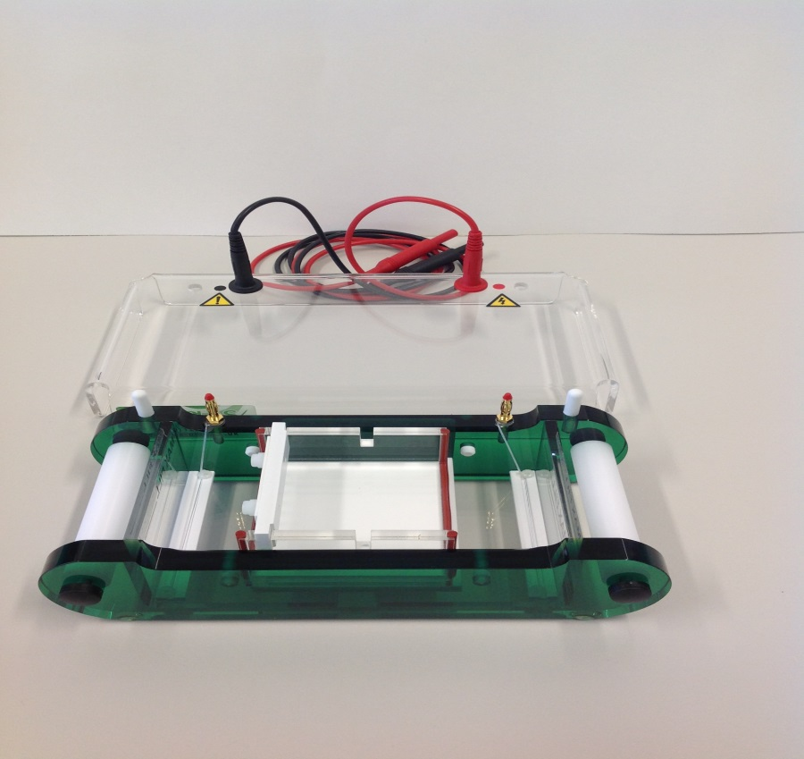
Gel electrophoresis
negative lead
positive lead
negative terminal
positive terminal
gel tray
Commercial electrophoresis equipment is available in the loan pool
Notes:
Electrophoresis set with cost approx $8000 in total (for 8 groups)

Slide 6
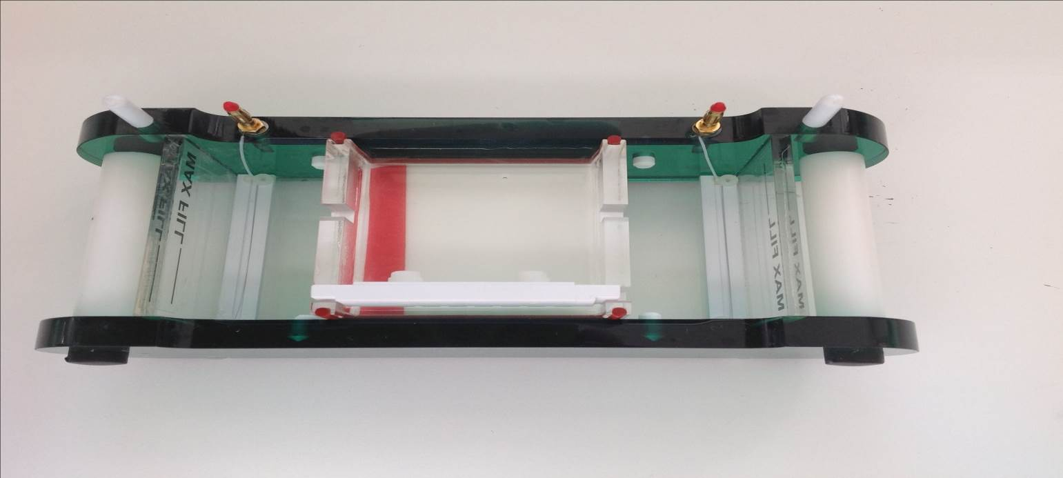
Preparing the gel casting tray
Rotate the tray so the rubber seals fit in tight against the tank wall
Place the comb into the edge slot checking the orientation is correct
Comb position and orientation – teeth away from edge
MS 062018
Notes:
The comb is placed at one end of the casting tray. This is done because the dyes supplied all run from the negative terminal to the positive terminal and because the trays are small, it will provide the dyes with the maximum amount of space to run (as opposed to starting them in the middle)
There are dyes that run the opposite way, but for this simulation, it’s easier to have them all going the same direction. If for instance you wanted to use your own set of food colours (as was done for the home-made sets), you could cast the gel with the comb in the centre to allow for some colours or parts of those dyes to run towards the positive end. Can be achieved on small trays, but is harder for students to do.
Please check the comb orientation is correct. This ensures the well holes are not cast too close to the edge of the gel, which can be damaged when the comb is removed.

Slide 7
Buffer solution
The buffer is used to create the gel and to fill the electrophoresis tank.
The buffer in the tank helps maintain the correct pH to perform electrophoresis.
For each tank make a 0.1% (w/v) buffer solution by dissolving 0.5g of sodium hydrogen carbonate in 500mL of tap water.
MS 062018
Notes:
We need to make enough buffer solution to not only make the gel but to also fill the tank so electrophoresis can occur.
Gel trays require a minimum of 70mL to fill and the tanks require a further 200mL.
Students (if they are casting their own gels) to make one litre between two groups (giving them 500mL for one tank)
If the Lab Tech or teacher is casting the gels (for 8 tanks) you will need to make a total of around 2.5L of buffer solution (2.5g bicarbonate in 2.5L of water) and then, using 600mL of this buffer solution, add 6 grams of agar and heat until dissolved.
Fortunately the cost of the quantities of agar and bicarbonate used are quite low, so making that little bit extra is easier than starting again.
The dyes and the chemicals used in this electrophoresis set are not toxic, however it would be best if gloves are used when handling the dyes as they stain skin and clothes quite easily.

Slide 8
Making the agar gel
The gel is the medium along which the dyes will travel and separate out on
Each tank requires a 1% (w/v) agar solution ie. 1g of agar into 100mL of buffer solution in a flask
Microwave the flask in short bursts 60 seconds initially, then in 30 second bursts, swirling gently in between until agar solution is clear.
MS 062018
Notes:
Students will need approx 100mL of agar gel per group, using the buffer solution to make it up.
Like the dyes, heated agar solution could be shared between two groups, so approx 200mL per conical flask to pour two gels.
It saves time if the solution can be heated up for the students at this point. (Ie Lab tech or teacher to heat up in microwave)
Heat the conical flask in the microwave for short bursts until the solution goes clear, 60 seconds initially, then 30 seconds thereafter – monitor the contents to ensure they don’t boil over.
The flask will get hot, so please handle carefully. Use paper towel folded into a collar to handle the flask and always move around the lab paying attention to who’s nearby. This part of the practical is usually done by the Lab Tech for a class of students, as logistically and safety wise it’s too difficult. Gels can be stored overnight with a small amount of buffer solution or made up several hours before a class. This is how most schools do this practical.

Slide 9
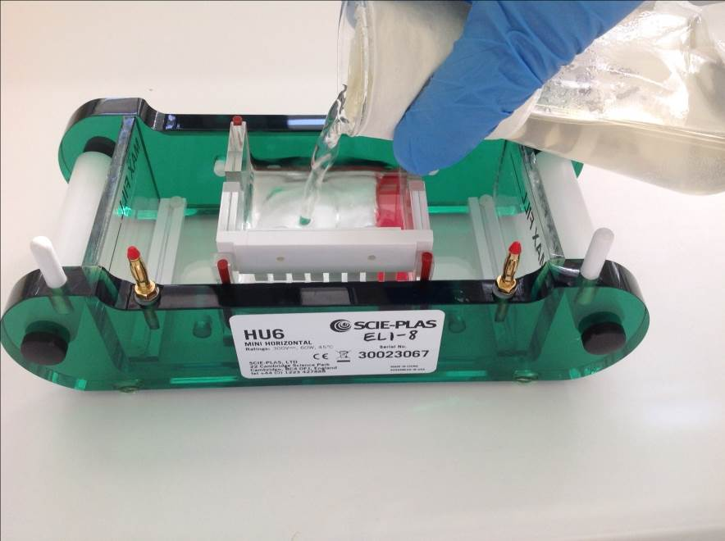
Pouring the agar gel
The agar must be cooled down to around 60ºC before pouring – or it may leak through the seals
Paper towel around the flask neck enables you to handle the hot flask
Pour agar to just under the base of the comb slot
Notes:
If gel is poured too high, it may form a ‘channel’ across the wells, allowing dyes to mix. So pour agar in to just below where the well slots join the comb.
Any bubbles formed on the top of the gel should be removed using a mounted pipette tip before it sets.
Gel will take approx 20-30minutes to set and will turn from clear to opaque when set.
If a gel is to be stored overnight, you will need to place it in an airtight container, covered with a small amount of buffer to prevent it from drying out.
Excess agar liquid agar can be poured into disposable petri dishes with a well comb, for students to practice loading dyes into (see gel electrophoresis preparation sheet for details)

Slide 10
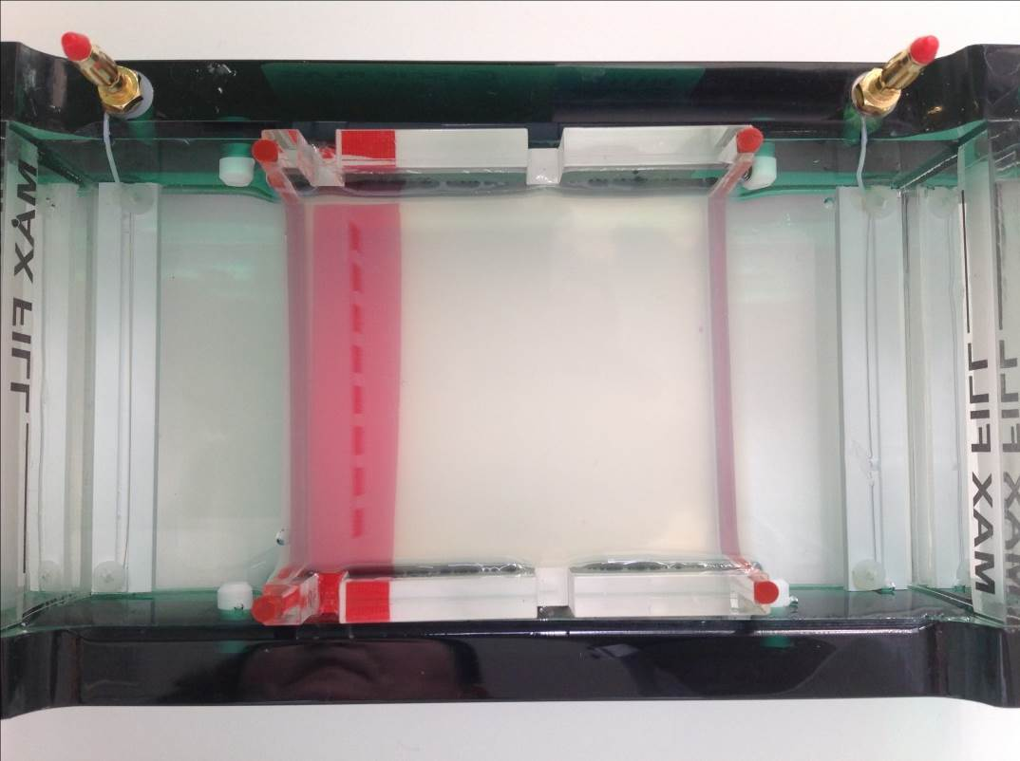
Setting up the tank
Once the gel is set, remove the comb and then lift tray out and rotate it 90 degrees, so that the wells are closest to the negative terminal.
Negative terminal
wells in gel
Notes:
This is the step where a lot of students go wrong. They must turn the tray to position the gel correctly before electrophoresis can be done.
A coloured surface under the tank can make it easier to see the wells when loading dyes.

Slide 11
Adding the buffer solution
Pour the buffer solution slowly into the tank, fill to the ‘max fill’ line – it should just cover the top of the gel
If the gel starts to float, gently push it back down into place
MS 062018
Notes:
Once you add the buffer solution to the gel, it becomes much harder to see the wells. This is where you’ll need to move around to find the best position to see them. A torch or microscope lamp can help to make the wells more obvious.
Some people like to put waterproof tape underneath the wells, which can help for some colours, but for others makes it harder. In a testing laboratory running DNA samples for instance, they would be loading a similar coloured sample and therefore could use the same contrasting background.

Slide 12
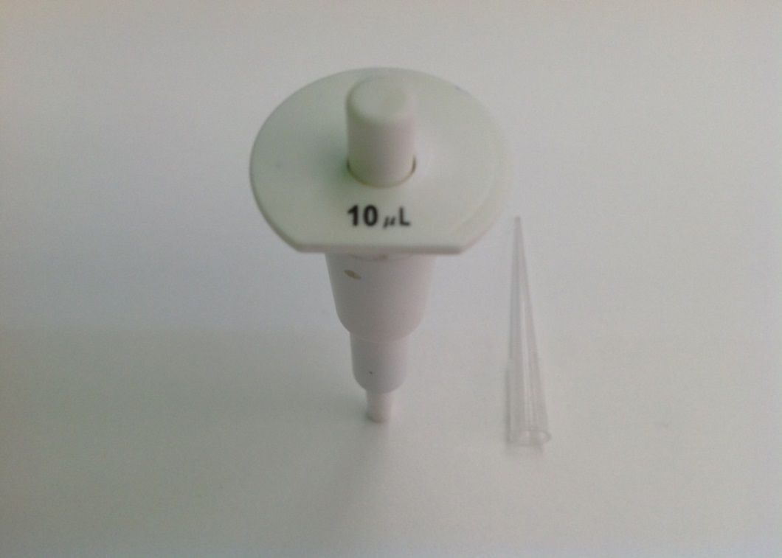
Fixed volume micropipette
Micropipette delivers 10uL of dye sample
Students should practice using these before loading dyes into the gel
Notes:
For students there is one fixed volume micropipette per tank and we supply a box of tips (each group needs 8 tips minimum)
As the dyes are water soluble and non-toxic, we ask that they be recycled as much as possible. A water filled beaker for each group to drop them into works well and then allowed to dry overnight on paper towel, before being packed up in the supplied container.
Good results are easier to obtain if students have been able to practice pipetting – use ‘practice’ gels cast in petri dishes (see preparation sheet for details)

Slide 13
Dyes
The dyes supplied in the loan pool sets are:
  Bromophenol blue (B)
  Orange G (OG)
  Rose Bengal (RB)
  Tartrazine (T)
  Xylene cyanol (XC)
  A ladder, or combination of all dyes (L)
  Samples (mixtures) numbered 1 through to 4
MS 062018
Notes:
The RTG blended combinations of 5 dyes to come up with 4 samples or mixtures (numbered 1 to 4) plus a ladder (combination of all 5 dyes).
Running these samples through electrophoresis should reveal what they are comprised of. You can use either the supplied samples or you can make up your own - extra eppendorf tubes are supplied if you choose to make your own.
Our base dyes are mostly the same as the ones supplied by the ‘Biotech out of the Box’ program run by Murdoch University. The only difference is that we supply Xylene cyanol instead of Indigo carmine as we found it was deteriorating too quickly and giving a poor result.
All dyes we supply are non-hazardous and they show a great simulation when applied well.
If you wanted to copy the Biotech out of the Box ‘samples’ to match the marine forensics scenario (available free online), you will need to mix some dyes, place into the extra eppendorf tubes and label them.
Some teachers may prefer to do this, or they may want to make up their own scenario.

Slide 14
Adding dyes to the gel
Select the dyes you want to use or, use the dyes the teacher has supplied
Write down what you’re going to use and in what order before pipetting, see next slide
Use a fixed volume micropipette to carefully transfer (or load) 10uL of each dye sample directly into the wells.
MS 062018
Notes:
If you’ve never used a micropipette before, it’s good to have a practice before you load dyes into the gel. Teachers will often get students to practice otherwise you end up with dye ‘bleeding’ out into the buffer solution. Agar gel with wells and a small amount of buffer solution made earlier are a great way to practice loading the dyes.
The technique to use with the micropipette: fit a tip to the pipette, open the eppendorf tube of dye, depress the button on top of the pipette, place tip into dye, release the button to draw up dye, remove from tube.
Have paper towel handy to wipe off dye from the external side of the tip – don’t draw all the dye out though.
With steady hands (hold one arm steady with other hand), place end of tip just into or directly above well, slowly press the button again to push out dye. Do not let the button back out until you pull it out of the buffer solution or else you might suck the dye back up. Dye should ‘fall’ into well – it has been mixed with glycerol to make it denser than the buffer.
Place used tip into a recycling container and get a new tip for the next dye.

Slide 15
Recording your dyes
Write down which dyes you are going to use, for example:
Well No. | Dye | Results
1 | Bromophenol blue
2 | Orange G
3 | Xylene cyanol
4 | Tartrazine
5 | Rose bengal
6 | Ladder
7 | Sample 2
8 | Sample 3
Dye separates out
Negative terminal Positive terminal
Notes:
This is an example of a table that can help make it easy for you to remember which dyes and samples you put into which well.
It doesn’t matter which end you put the known and unknown dyes into, as long as you know what well number they are in relation to the negative electrode or terminal.
So in this case we have started with Bromophenol blue at the top and worked down to Sample 3

Slide 16
Safety
Precautions to prevent electrical shock and using electrophoresis apparatus safely include:
Ensure power is off before connecting the electrical leads
Ensure that your hands are dry while connecting the leads
Keep the apparatus away from sinks or other water sources
Turn off power before opening lid or reaching inside chamber
Do not run electrophoresis equipment unattended
Notes:
Students must be made aware that the apparatus is potentially dangerous if not used correctly
Teachers need to ensure students wait for their equipment to be checked before turning power packs on

Slide 17
Safety
Before attaching the lids to the tanks, ensure that the power packs are NOT connected to power
Once the gels are loaded with dyes, attach the lids to the tanks
Attach the leads of the electrophoresis tank to the power pack (red to red and black to black)
DO NOT switch the power pack on until your teacher has checked your set up
MS 062018
Notes:
IMPORTANT - Power packs must not be turned on until tanks are connected - the power packs are high voltage and must be used with care.

Slide 18
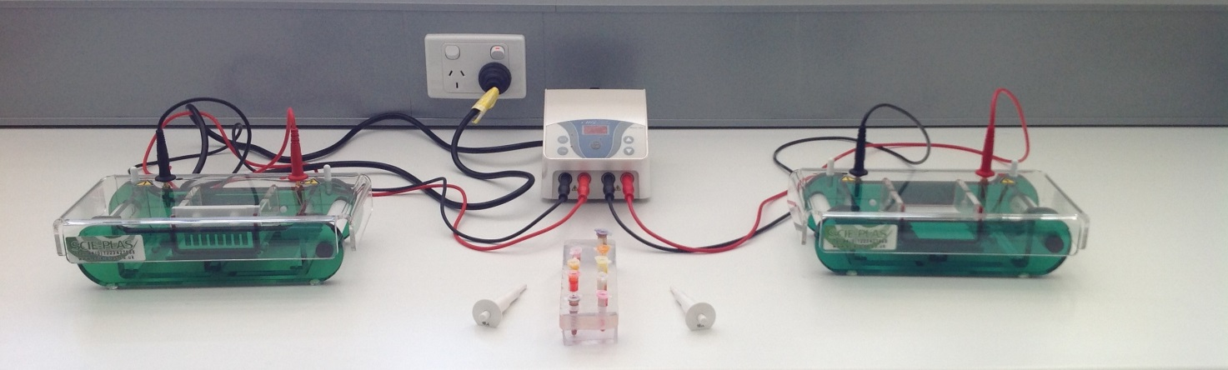
Workspace setup
Tanks set up and connected
A workstation has two tanks run off of one power pack
MS 062018
Notes:
Teacher must check both groups tank setup before switching the power pack on. Connecting leads are screwed into the lid clockwise, matched to the coloured dots. Leads push down onto gold plated electrode connecters.
Each work station has 2 groups working together, ensuring both tanks are ready before electrophoresis occurs.
Please note: Dyes are water soluble, but it is recommended that students protect bench top with paper towel.

Slide 19
Performing gel electrophoresis
Once the power pack is connected to the electrophoresis tank, switch on the power pack and set to 100V for 30 minutes
If the power pack has current adjustment, ensure it is set at 250mA
Start electrophoresis, bubbles will form at the electrodes of the tank when the voltage is applied - if bubbles are not visible switch the power pack off and notify your teacher
Press the ‘stop’ button once the power pack has run for 30 minutes
MS 062018
Notes:
When everything is set up switch the power pack on at the back of the unit. Use the up and down buttons to adjust the voltage and then the time accordingly.
Important – if the power pack has current adjustment, ensure this is set at 250mA. Once electrophoresis is started, tiny bubbles will immediately start appearing at each electrode.
If the connection between the power pack and the tanks is not adequate, an error code will appear on the tank display as ‘nLD’ or ‘no load’ and no electrophoresis will occur until the connection is made. Students must notify the teacher or technician to fix this.
Try the following: Turn off the power pack and disconnect the tank leads from the power pack. Check the leads are screwed all the way down into the tank lid and that the lid is pushed down as far as it will go onto the tank. Check the wires in the electrophoresis tank are intact and that the buffer solution is up to the max fill line. If all is correct, reconnect the tanks to the power pack and restart electrophoresis – if the error code reappears, the tank(s) will need to be removed from service and other tanks used. Please tag any tanks not working for RTG to repair.
Otherwise, once the 30 minutes at 100V has finished, the dyes should be adequately separated. If further separation is required, you can put the lid back on the tank, connect the leads to the power pack and run electrophoresis for 10 more minutes at 100V. Longer run periods may result in the gel melting.

Slide 20
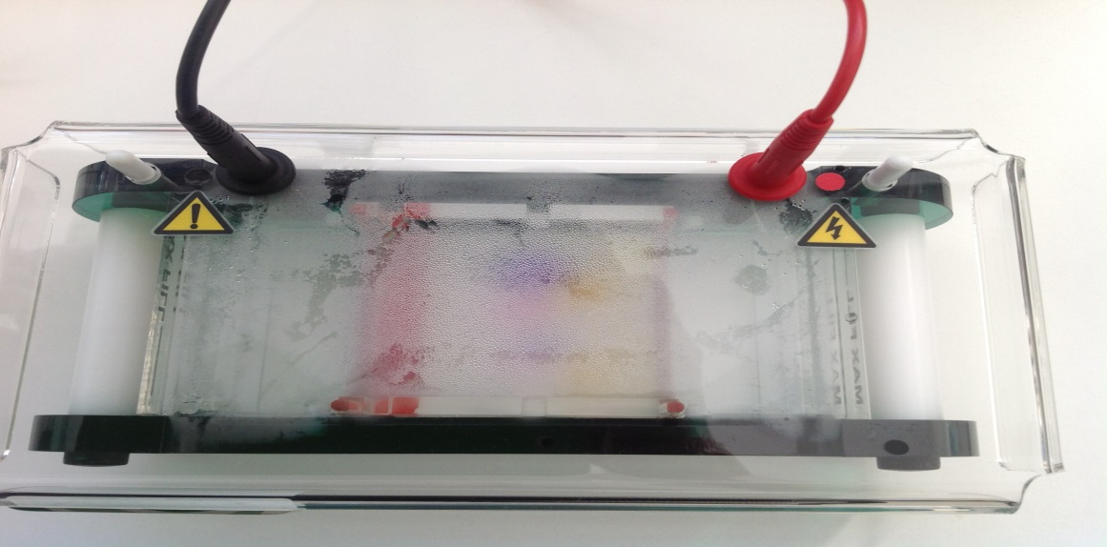
Performing gel electrophoresis
If left on for too long, dyes will migrate out the end of the gel and the gel could melt
Fogging up inside the tank during electrophoresis is normal
Condensation forming on the lid
Notes:
The lid will most likely fog up a bit – this is normal. If you really needed to remove the lid to wipe it you could do so, but only if you turn off the power pack and disconnect it from the power point. The dyes will resume to migrate once you connect it up and press start on the power pack again.

Slide 21
Performing gel electrophoresis
Once the dyes have migrated sufficiently, turn off the power pack, disconnect it from the power socket, remove leads from power pack and then remove lid by pressing down on white lugs
Check if the buffer is cool enough, then remove the casting tray with gel inside
Compare the migration of the sample dyes with the known dyes
MS 062018
Notes:
You need to ensure everything is disconnected from power before you take the lids off.
The buffer can get fairly warm during electrophoresis, so just check its not too warm by feeling the outside of the tank before you take out the gel.

Slide 22
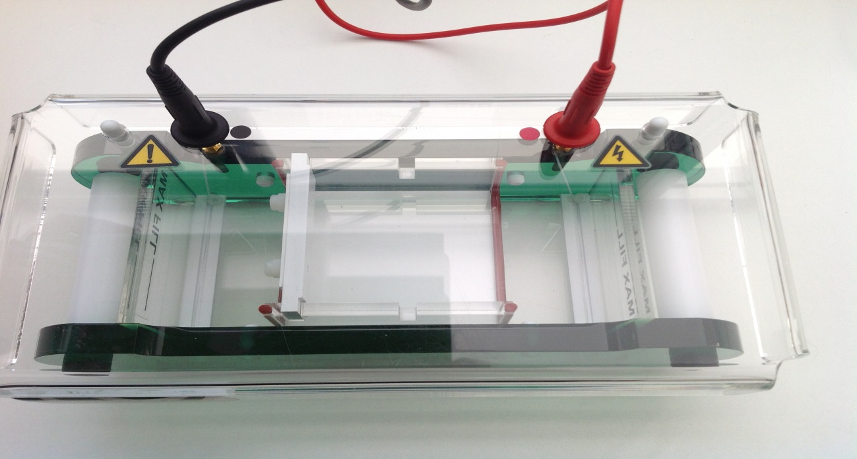
Removing the tank lid
Lid can be removed by pressing down on white plastic lugs and pulling lid up underneath
MS 062018
Notes:
Please note:
Lids must be removed carefully by pressing down on the white lugs and pulling up the lid from underneath. Do not attempt to unscrew the leads while they are still connected to the tank or you will damage the terminals.

Slide 23
Interpreting Results
- example separation
Starting point at well
1 2 3 4 5 6
Unknown dye in well No.6 had the same dye as well No.4
Wells 1 – 4 have known dyes
Ladder at well No. 5
MS 062018
Notes:
Dyes have migrated to their opposite poles and have been separated (migrated different lengths) based on their molecular weight/shape.
In this photo we can see the four standards or known samples on the left side. Immediately to the right (at well number 5) is a ladder sample - it contains all four known samples.
Comparing the known dyes, the sample in well number 6 contains known dye No. 4 only. Have a look at your known dyes and see what the unknown sample(s) you ran are comprised of.
The teacher will relate this simulation to DNA and protein analysis using electrophoresis.
Some factors that influence the rates of migration
The type of substance used to create the gel ( I.E. Agar/ Agarose) creates different sized pores which leads to different degrees of separation.
Gels are made up to a certain percentage (w/v). Higher percentage gels are more suitable for separating substances of smaller molecular weights where lower percentage gels are more suitable to separate higher molecular weight chemicals.
The molecular weight and shape of the molecule ( I.E linear vs circular) influences the distance of migration of the substance and results in molecules migrating different distances.

